Slide 1
CSE 2217: Data Structure and Algorithms-II
Time Complexity Analysis

Slide 2
Time Complexity Part 3
Look for:
Return statements
Break statements
Continue Statements

Slide 3
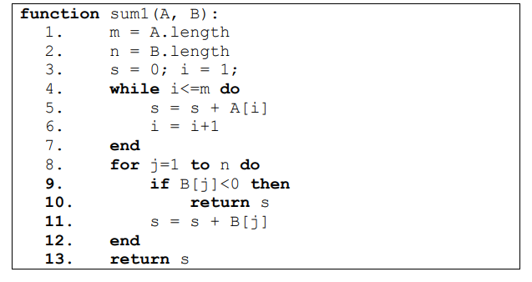
Time Complexity Analysis
Problem 1:
Exact Cost/ Time Analysis
Best Case Time Analysis
Worst Case Time Analysis
Show a best case and a worst case

Slide 4
Time Complexity Analysis
Cost
Times
c1
1
c2
1
c3
1
c4
m+1
c5
m
c6
m
c7
n+1
c8
n/1
c9
1
c10
n
c11
1

Slide 5
Time Complexity Analysis
Cost
Times
c1
1
T(n)=
(c1+c2+c3+c4)+
m(c4+c5+c6)+
n(c7+c8+c10)+ c11
= Am+Bn+c
Best Case:
The first loop will run fully m times
The second loop will run only once
T(n)=Am+B+C = O(n)
Worst Case:
First loop runs – m times
Secod loop runs - n times
T(n) = Am+Bn+c = O(m+n)
c2
1
c3
1
c4
m+1
c5
m
c6
m
c7
n+1
c8
n/1
c9
1
c10
n
c11
1

Slide 6
Time Complexity Analysis
Cost
Times
Best Case:
c1
1
1 | 2 | 3 | 4 | 5
c2
1
-1 | 5 | 6 | 7 | 8
c3
1
c4
m+1
Worst Case:
c5
m
c6
m
1 | 2 | 3 | 4 | 5
n+1
1 | 1 | 1 | 1 | 1
c7
c8
n/1
c9
1
c10
n
c11
1

Slide 7
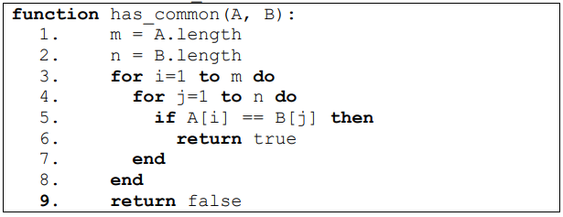
Time Complexity Analysis
Problem 2:
Exact Cost/ Time Analysis
Best Case Time Analysis
Worst Case Time Analysis
Show a best case and a worst case

Slide 8
Time Complexity Analysis
O(1)
O(1)
O(m)
O(n)
O(m)
O(n)
O(m)
O(1)
O(1)

Slide 9
Time Complexity Analysis
T(n)= O(mn)
Best case:
O(1)
Worst Case:
O(mn)
O(1)
O(1)
O(m)
O(n)
O(m)
O(n)
O(m)
Best Case:
O(1)
1 | 2 | 3 | 4 | 5
1 | 2 | 3 | 4 | 5
Worst Case:
O(1)
1 | 1 | 1 | 1 | 1
2 | 2 | 2 | 2 | 2

Slide 10
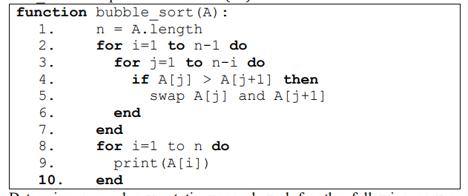
Time Complexity Analysis
Problem 3:
Exact Cost/ Time Analysis
Best Case Time Analysis
Worst Case Time Analysis
Show a best case and a worst case

Slide 11
Time Complexity Analysis
O(1)
O(n)
O(n)
O(n)
O(n)
O(n)
O(n)
O(n)
O(n)
O(n)

Slide 12
Time Complexity Analysis
O(1)
There are no return or break statements.
All the loops will run.
So the time complexity for all cases is
O(n²)
Best case and worst case example
Any array
O(n)
O(n)
O(n)
O(n)
O(n)
O(n)
O(n)
O(n)
O(n)

Slide 13
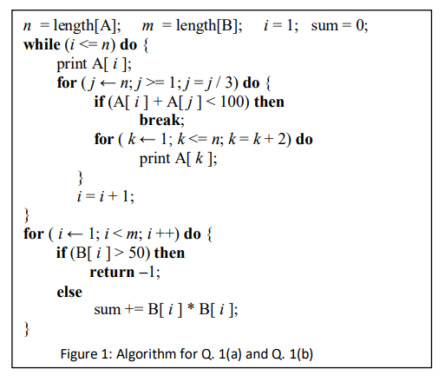
Time Complexity Analysis
Problem 4:
Exact Cost/ Time Analysis
Best Case Time Analysis
Worst Case Time Analysis
Show a best case and a worst case

Slide 14
Time Complexity Analysis
O(1)
O(n)
O(1)
O(log₃n)
O(1)
O(log₃n)
O(n)
O(1)
O(n)
O(log₃n)
O(n)
O(n)
O(log₃n)
O(n)
O(m)
O(1)
O(m)
O(1)
O(1)
O(m)

Slide 15
Time Complexity Analysis
O(1)
O(n)
O(1)
T(n) =
O(n²log₃n)+O(nlog₃n)+O(n)+O(m)+O(1)
= O(n²log₃n)+O(m)
O(log₃n)
O(1)
O(log₃n)
O(n)
O(1)
O(n)
O(log₃n)
O(n)
O(n)
O(log₃n)
O(n)
Best Case:
The first loop breaks early and the last loop returns early.
T(n) = A.1 + B.1 + Cn + D.1 = O(n)
Worst Case:
T(n)= O(n²log₃n)+O(m)
O(m)
O(1)
O(m)
O(1)
O(1)
O(m)

Slide 16
Time Complexity Analysis
O(1)
O(n)
O(1)
T(n) =
O(n²log₃n)+O(nlog₃n)+O(n)+O(m)+O(1)
= O(n²log₃n)+O(m)
O(log₃n)
O(1)
O(log₃n)
O(n)
O(1)
O(n)
O(log₃n)
O(n)
O(n)
O(log₃n)
O(n)
Best Case:
The first loop breaks early and the last loop returns early.
T(n) = A.1 + B.1 + Cn + D.1 = O(n)
Worst Case:
T(n)= O(n²log₃n)+O(m)
O(m)
O(1)
O(m)
O(1)
O(1)
O(m)

Slide 17
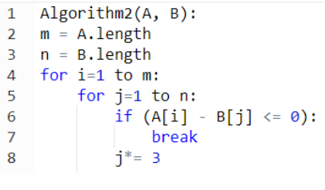
Time Complexity Analysis
Problem 5:
Exact Cost/ Time Analysis
Best Case Time Analysis
Worst Case Time Analysis
Show a best case and a worst case

Slide 18
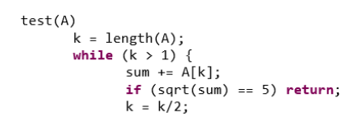
Time Complexity Analysis
Problem 6:
Exact Cost/ Time Analysis
Best Case Time Analysis
Worst Case Time Analysis
Show a best case and a worst case

Slide 19
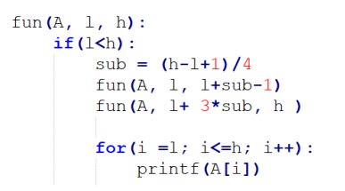
Time Complexity Analysis
Problem 7:
Determine the recursive equation for time

Slide 20
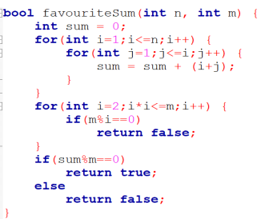
Time Complexity Analysis
Problem 8:
Exact Cost/ Time Analysis
Best Case Time Analysis
Worst Case Time Analysis
Show a best case and a worst case

Slide 21
Thank You

